Slide 1
NIH eRA Workshop: Grant Application Preparation & Submission
November 2019
electronic Research Administration (eRA)
OER, OD, National Institutes of Health
Phoenix, AZ

Slide 2
Your Workshop Team
Sheri Cummins
Office of Extramural Research (OER) Communications & Outreach Chief, Grants Information
cumminss@od.nih.gov
Laurie Roman
Electronic Research Administration (eRA) Customer Relationship Manager
laura.roman@nih.gov

Slide 3
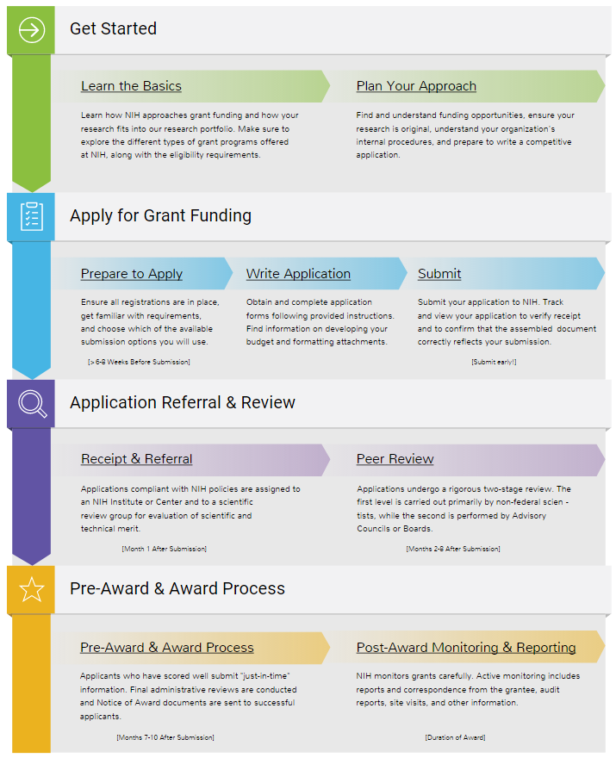
Today’s Topics
Prepare to Apply
Systems & Roles
Registrations
Understanding Funding Opportunity Announcements
Explore a sample FOA
Types of Applications
Submission Options
Submission Policies
Sample scenarios
Application Process Step-by-step
Avoid the “gotchas” activity
What’s New or Happening Soon
Finding Help & Resources
Wrap-up

Slide 4
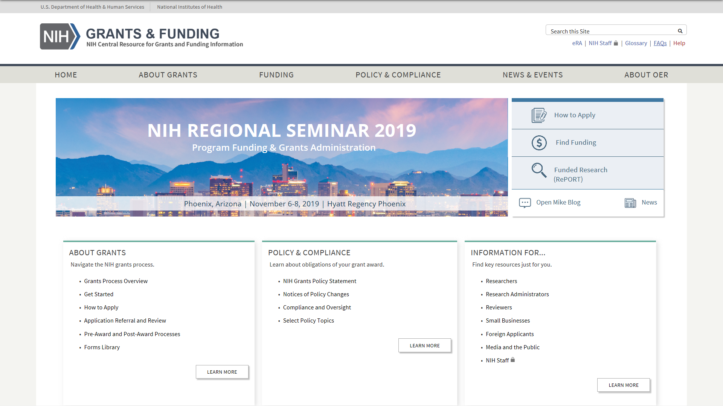
NIH Grants & Funding
Bookmark https://grants.nih.gov/
How to Apply- Application Guide

Slide 5
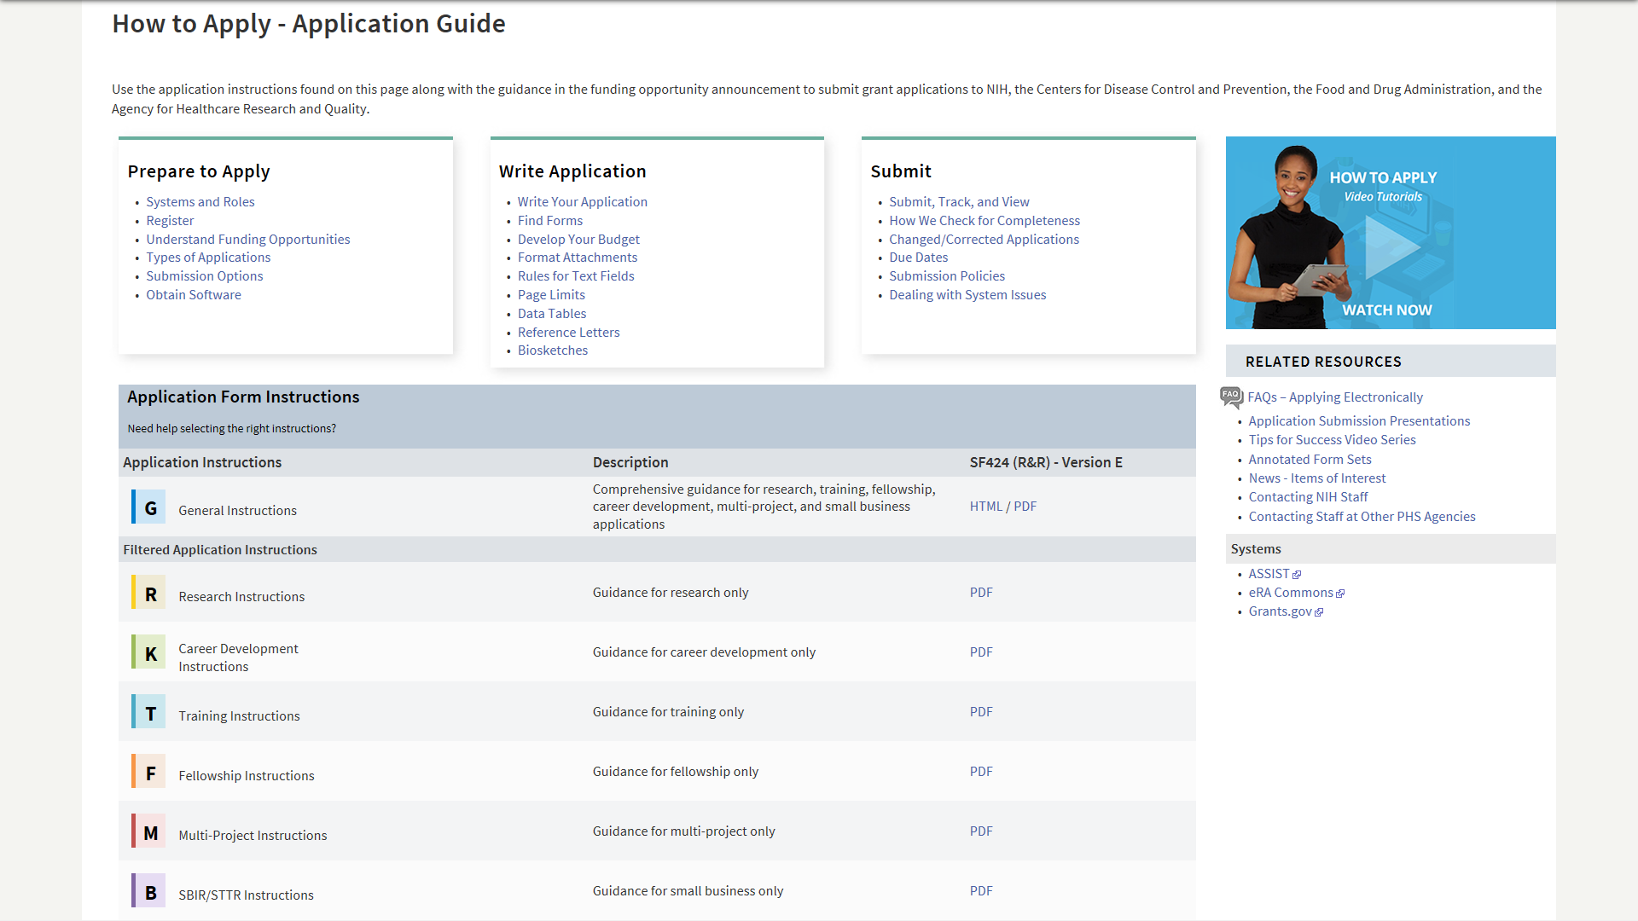
How to Apply – Application Guide
General Application Process Information
Resources
Form Instructions

Slide 6
Before Jumping Into the Application Process, Let’s Cover Some Basics

Slide 7
Understand Key Systems & Roles
Grants.gov
eRA Commons
E-Business Point of Contact (EBiz POC)
Authorized Organization Representative (AOR)
Signing Official (SO)
Principal Investigator (PI)
https://grants.nih.gov/grants/how-to-apply-application-guide/prepare-to-apply-and-register/key-systems-and-roles.htm

Slide 8
Organization Registration
DUNS – provides unique organization identifier
NOT-OD-19-098 - Notification of Upcoming Change in Federal-wide Unique Entity Identifier Requirements
GSA Unique Entity Identifier Update page
SAM (System for Award Management) – required to do business with government
Requires annual renewal
Grants.gov – required to submit grants
eRA Commons – required to do business with NIH
SBA (Small Business Administration) – required for small business applications
https://grants.nih.gov/grants/how-to-apply-application-guide/prepare-to-apply-and-register/registration/org-representative-registration.htm

Slide 9
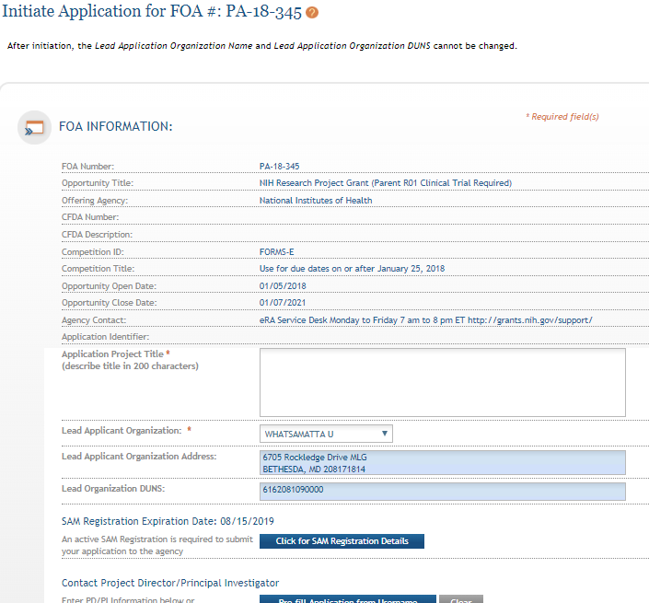
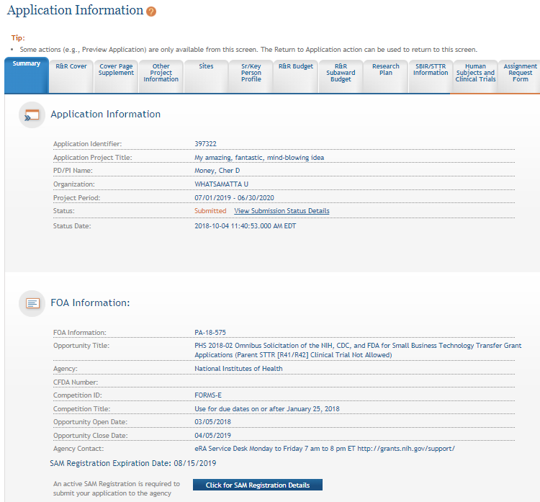
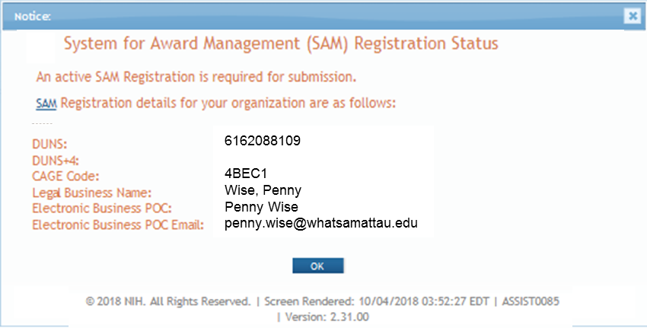
Visibility of SAM Registration Status in ASSIST
Initiate Screen
Application Information Screen

Slide 10
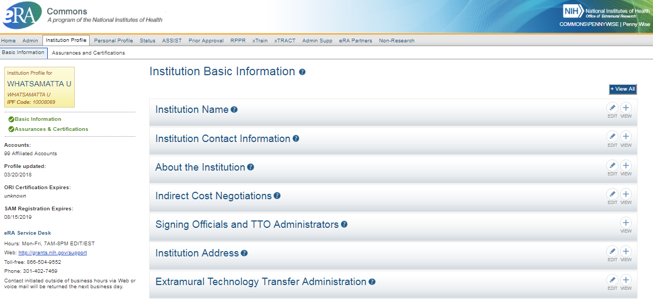
Visibility of SAM Registration Status in eRA Commons

Slide 11
Individual eRA Commons Registrations
Who needs an eRA Commons account?
At least one Signing Official (SO)
Project Director/Principal Investigator (PD/PI) and any multiple-PD/PIs
Component leads on a multi-project application
Sponsor on a fellowship application
Candidates for diversity and re-entry supplements
Primary mentor identified on individual mentored career development applications
Anyone doing data entry in ASSIST
If awarded, additional individuals may need accounts for reporting purposes
https://grants.nih.gov/grants/how-to-apply-application-guide/prepare-to-apply-and-register/registration/investigators-and-other-users/era-commons-user-registration.htm

Slide 12
Account - Tips
Log in to accounts prior to deadline to ensure you have access
Designate more than one Signing Official (and AOR)
Check for existing eRA Commons account before creating a new one
Ask the person if they already have an account, or search within the Commons
If a user already has an account with a different organization, you should affiliate the existing account with the user’s new organization
Do not mix PI and SO roles on same account
If a person serves both roles (e.g., small business), they must have two accounts
PIs should update their eRA Commons profile prior to submitting
E.g., info used to determine Early Stage Investigator (ESI) eligibility

Slide 13
Understanding Funding Opportunities
Funding Opportunity Announcement (FOA)
A publicly available document by which a Federal Agency makes known its intentions to award discretionary grants or cooperative agreements, usually as a result of competition for funds.
NIH grant applications are submitted in response to a specific FOA
Pay attention to notices posted in the NIH Guide for Grants and Contracts
Notices may update key aspects of FOAs or highlight topics of special interest to NIH
https://grants.nih.gov/grants/how-to-apply-application-guide/prepare-to-apply-and-register/understand-funding-opportunities.htm

Slide 14
Increased Use of Notices of Special Interest
Highlight areas of scientific interest
Designate existing FOAs to use for application submission
May include additional submission instructions that supersede the instructions in the FOA or application guide
Most require the notice number in the Agency Routing Identifier field (4b) on the SF424 R&R form
May identify NIH Institutes or Centers participating in the notice initiative that are not listed in the FOA used for submission
Including the notice number in the Agency Routing Identifier field alerts our Receipt & Referral staff of your intentions regarding Institute assignment

Slide 15
Types of FOAs
Parent Announcements
Program Announcements (PAs)
Requests for Applications (RFAs)
Let’s take a quick peek at this link.
https://grants.nih.gov/grants/how-to-apply-application-guide/prepare-to-apply-and-register/understand-funding-opportunities.htm

Slide 16
Clinical Trial Specific FOAs
NIH requires that all applications involving one or more clinical trials be submitted through a Funding Opportunity Announcement (FOA) specifically designed for clinical trials.
Improves our ability to
identify proposed clinical trials;
ensure key trial-specific information is submitted; and
Uniformly apply trial-specific review criteria.
FOAs include clinical trial allowability indicator
Section II of all FOAs
Title of most FOAs
If title does not include clinical trial allowability indicator, then independent clinical trials are NOT allowed
https://grants.nih.gov/policy/clinical-trials/specific-funding-opportunities.htm

Slide 17
Special Consideration for Programs Focused on Early Career Stages
Fellowship (Fs) | Training (Ts) | Career Development (Ks)
All FOAs are “Independent Clinical Trial Not Allowed” Fellows can still play an active role and gain experience in clinical trials led by a sponsor/co-sponsor as part of their research training | All FOAs are “Independent Clinical Trial Not Allowed” Appointed Trainees can still play an active role and gain experience in clinical trials led by a mentor or co-mentor | Some FOAs are “Independent Clinical Trial Not Allowed” Candidates can still play an active role and gain experience in clinical trials led by a mentor/co-mentor as part of their research career development Others are “Independent Clinical Trial Required” or “Independent Basic Experimental Studies with Humans Required” Allow independent clinical trials
Why aren’t fellows and trainees allowed to lead an independent clinical trial?
Fellows and trainees may not yet possess the skills to independently lead a clinical trial and navigate all the components, complexities, and reporting requirements
Fellowship and training grants do not include sufficient research funds to support the majority, if not all types, of clinical trials

Slide 18
Identify Type of Application
Number Type | Stage/Description
Type 1* | New - Request for support of a project that has not yet been funded.
Type 2* | Renewal - Request for additional funding for a period subsequent to that provided by a current award.
Type 3* | Competitive Revision* – Request for additional funds to expand the scope of a current award. Administrative Supplement Revision – Request for additional funds to cover unforeseen, increased costs to carry out current award.
Type 6 | Change of Organization Status (Successor-in-Interest)
Type 7 | Change of Grantee or Training Institution
* Resubmission - Unfunded application that has been modified following initial review and resubmitted for new consideration.
https://grants.nih.gov/grants/how-to-apply-application-guide/prepare-to-apply-and-register/type-of-application-submission.htm

Slide 19
Why is knowing the type of application important?
Potential impact on…
Due dates
E.g., If submitting to an R01 opportunity with standard due dates, “New” applications have a different due date than “Resubmission”, “Renewal” or “Revision” applications.
Ability to submit to a specific announcement
Application validations
We enforce different rules based on your selection in the “Type of Application” field (#8) of the SF424 (R&R) form.

Slide 20
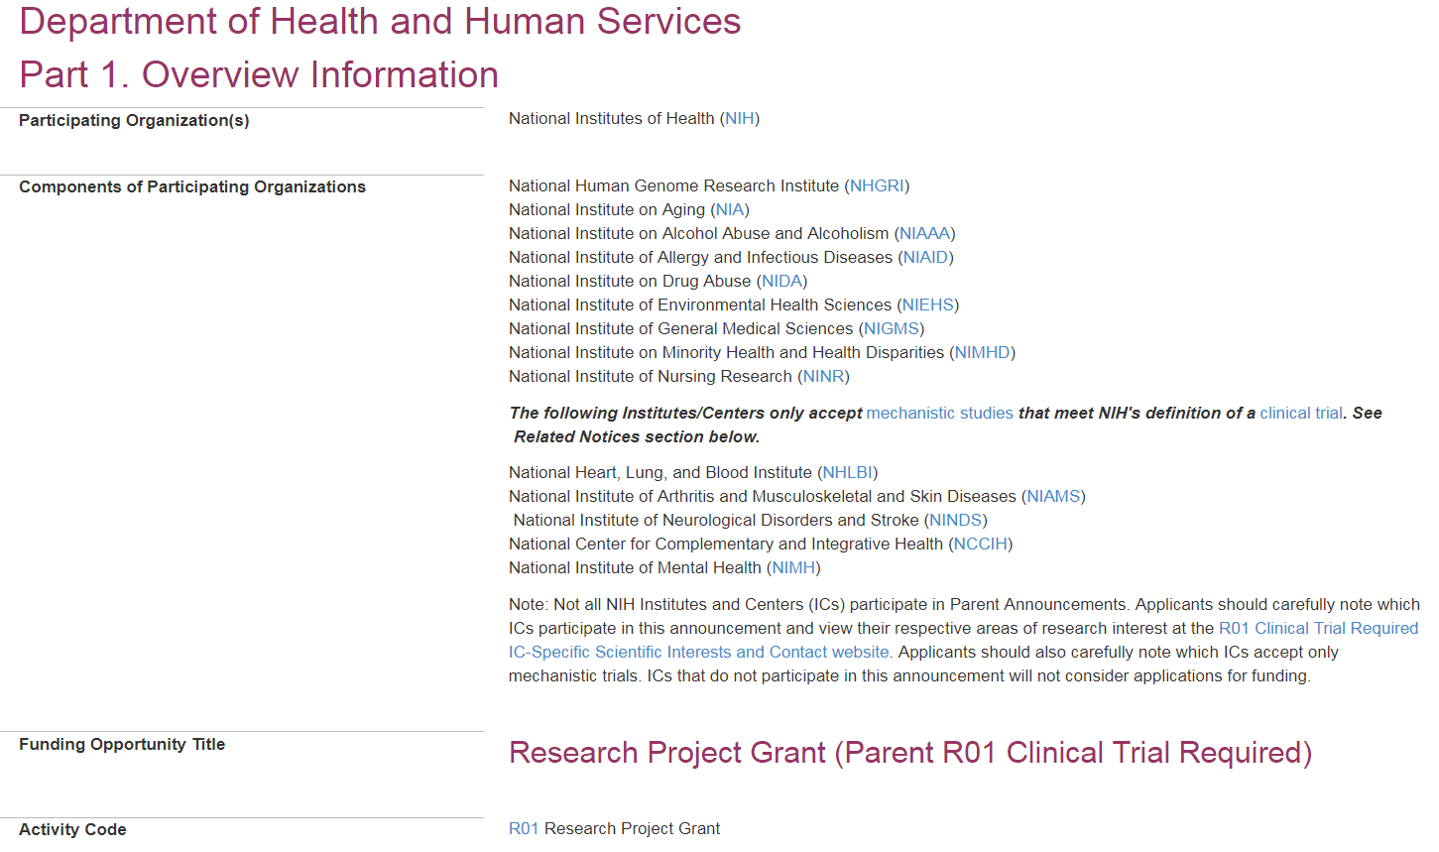
Now let’s look at an actual FOA…
PA-19-055

Slide 21
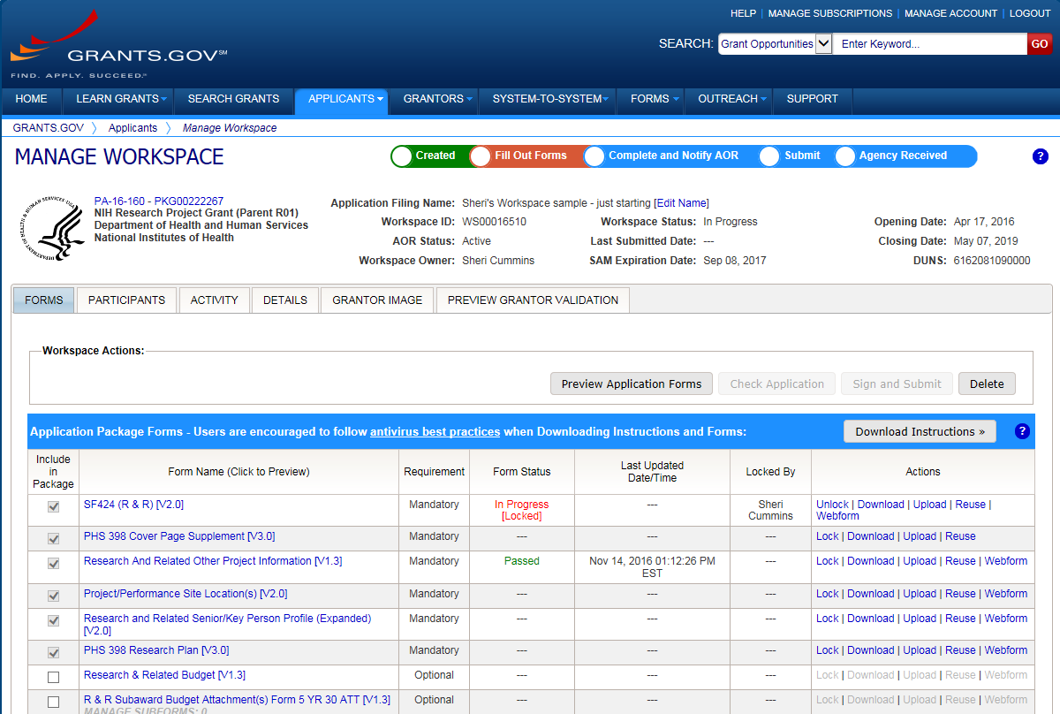
Submission Options Supported by NIH
ASSIST
System-to-System
Workspace
https://grants.nih.gov/grants/how-to-apply-application-guide/prepare-to-apply-and-register/submission-options.htm

Slide 22
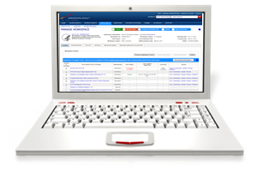
Comparison of Submission Options
NIH ASSIST
Grants.gov Workspace
Managed by NIH
Multi-user access
Leverages eRA Commons accounts
Pre-population from eRA Commons profiles
Pre-submission validations
Pre-submission preview in agency format
Track application status in a single system
Copy data to different application package
Supports all NIH competing applications
Pull study information from ClinicalTrials.gov
Integrated NIH messaging (tips, system alerts)
Managed by Grants.gov
Multi-user access
Requires additional user registrations
No pre-population from existing profiles
Pre-submission validations
Pre-submission preview in agency format
Must track application in multiple systems
Reuse forms; copy application data
Supports NIH single-project competing applications (no multi-project support)
https://grants.nih.gov/grants/how-to-apply-application-guide/prepare-to-apply-and-register/submission-options/assist.htm
https://www.grants.gov/web/grants/applicants/workspace-overview.html

Slide 23
System-to-System (S2S) Solution
Managed by institution or service provider
Typically integrate with other internal systems and databases to reduce data entry
Features vary by solution
Examples of potential features
Secure, on-line data entry
Concurrent user support
Pre-submission verification of some NIH business rules
Pre-submission preview of assembled application image in generic or agency format
eRA Commons application status information

Slide 24
Your Application will be…
Subject to the same registration requirements
Completed with the same data items
Routed through Grants.gov
Validated against the same NIH business rules
Assembled in a consistent format for review consideration
Tracked in eRA Commons
…regardless of submission option used.

Slide 25
How Do I Get to the Forms?
Each FOA has its own unique set of forms
Use one of the available submission options to access, prepare, and submit the forms needed to apply
Check with your administrative officials before choosing how to submit
https://grants.nih.gov/grants/how-to-apply-application-guide/format-and-write/find-forms.htm

Slide 26
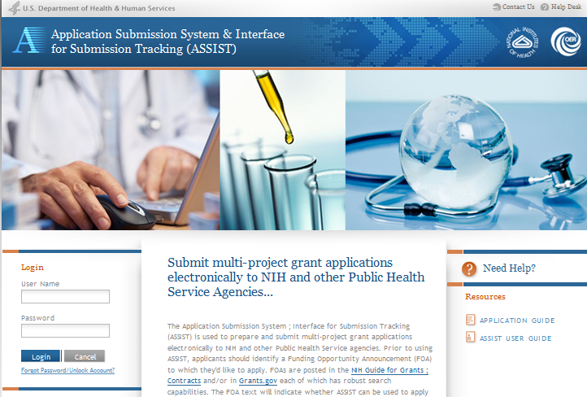
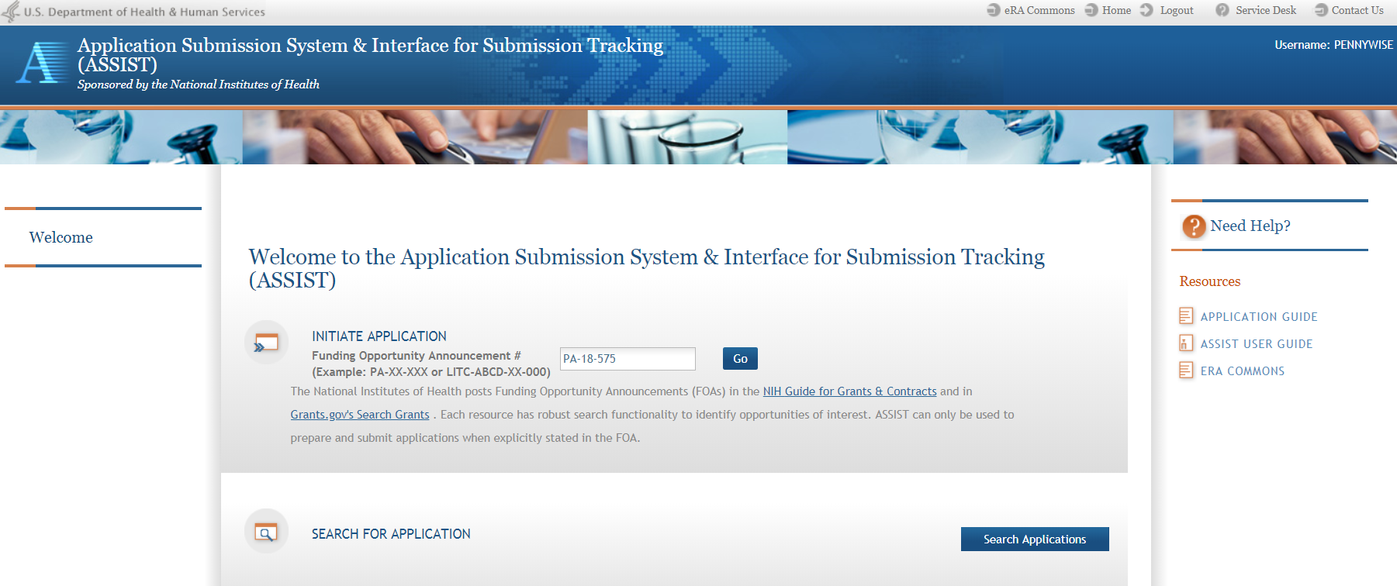
Access Application Forms via ASSIST
Excerpt from single-project FOA in NIH Guide…

Slide 27
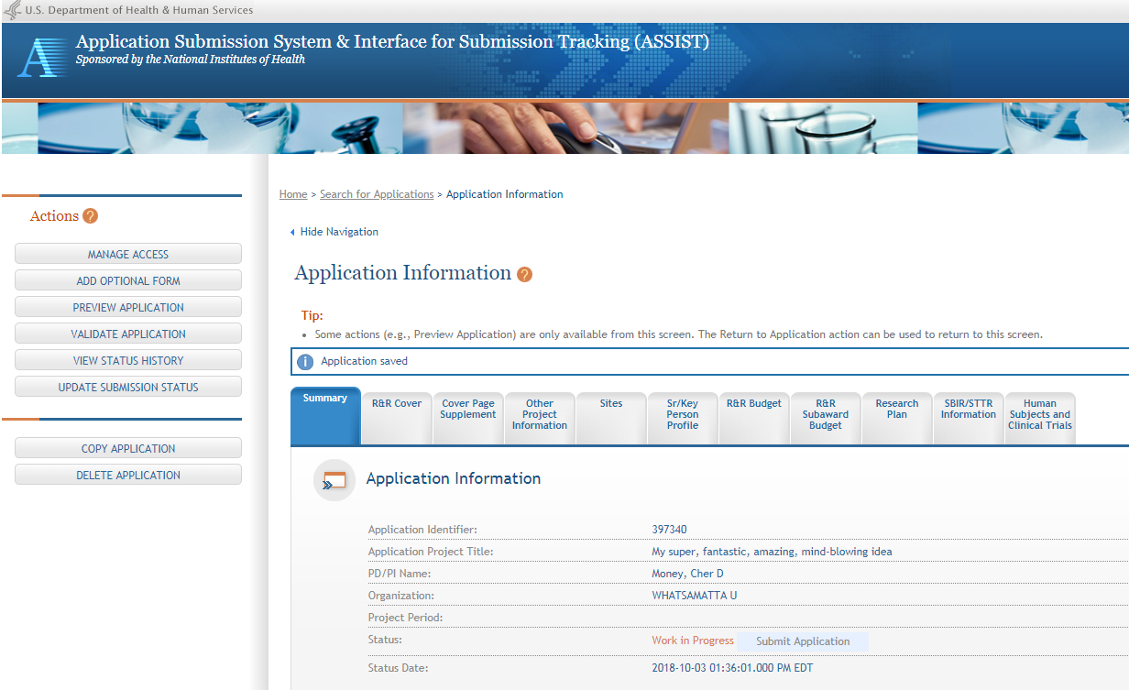
ASSIST screen layout
Application forms

Slide 28
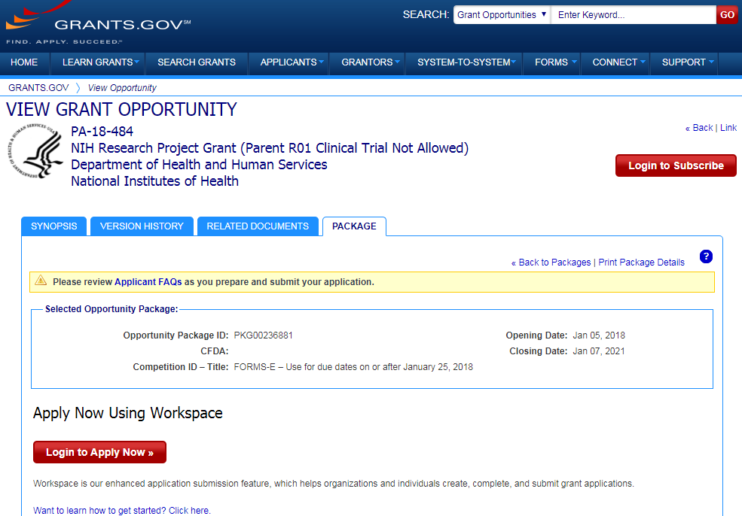
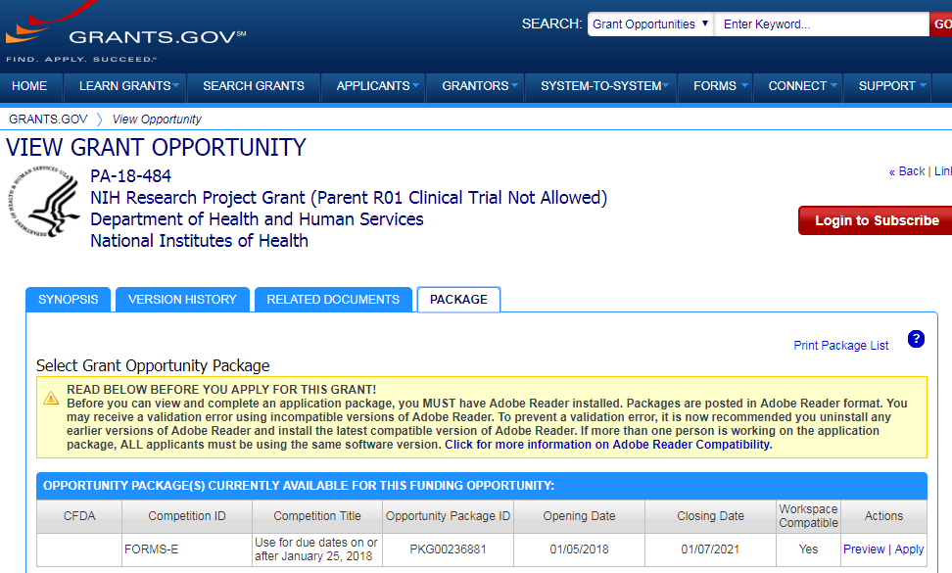
Access Application Forms via Workspace
Excerpt from single-project FOA in NIH Guide…

Slide 29
Sample Workspace Screen
Application forms list
Access forms using Download/Upload actions or enter data directly into Webform

Slide 30
Submission Policies

Slide 31
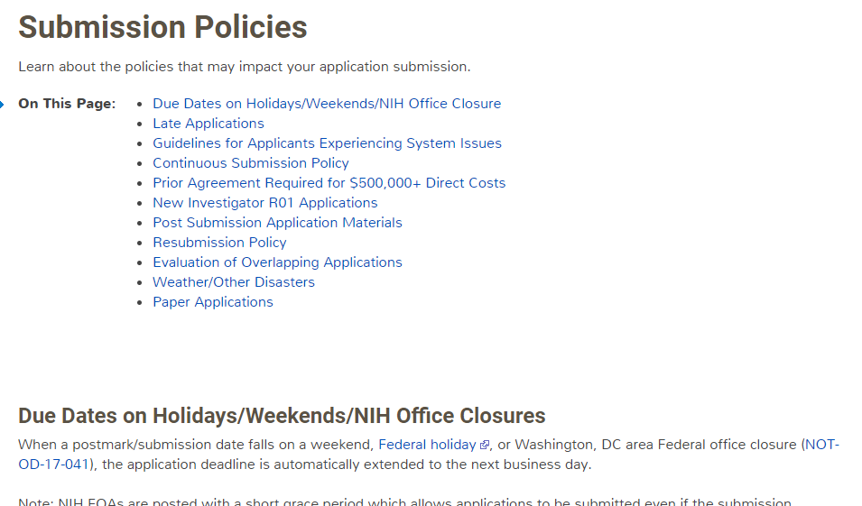
Submission Policies Page
https://grants.nih.gov/grants/how-to-apply-application-guide/due-dates-and-submission-policies/submission-policies.htm

Slide 32
Now Let’s Talk About the Application Process
Step 1: Find
Step 2: Plan
Step 3: Initiate
Step 4: Build team
Step 5: Enter data
Step 6: Finalize
Step 7: Submit
Step 8: Track

Slide 33
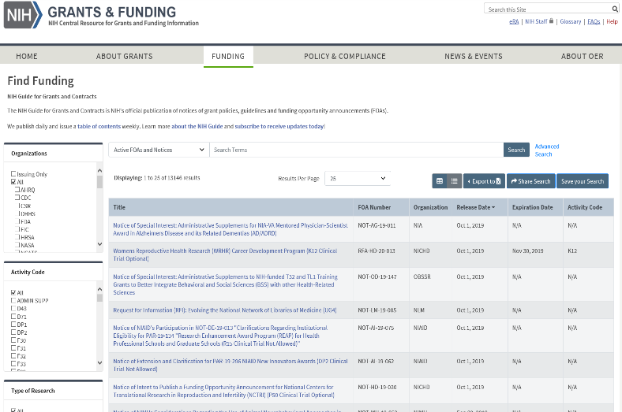
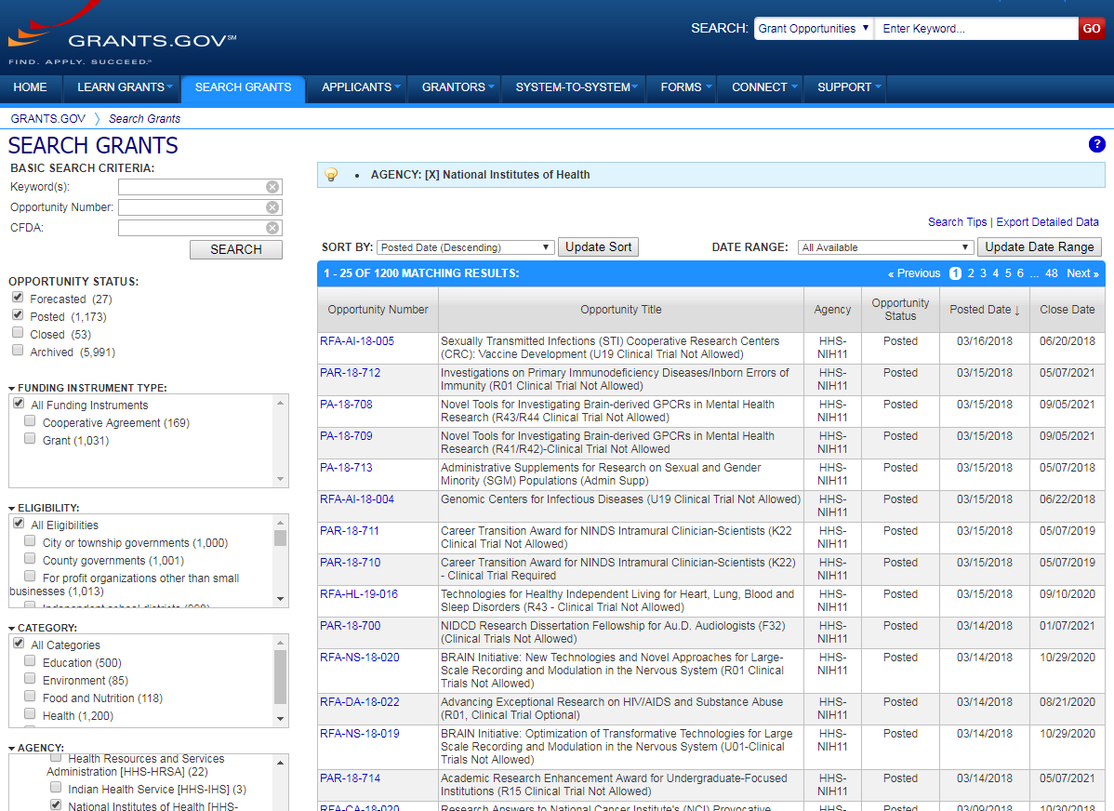
Step 1: Find an Opportunity of Interest
NIH Guide to Grants & Contracts
Grants.gov Search Grants
FOAs
NIH, AHRQ, CDC (subset), FDA (subset)
Notices
Notices of special interest
Policy updates
Changes to FOAs
RFIs
Webinars and training events
And more
FOAs
All federal grant making agencies
Each system has robust search capabilities.

Slide 34
Check for fit before you submit!
Program description
FOA Part 2, Section I Funding Opportunity Description
Participating institutes
FOA Part 1, Participating Organizations & Components of Participating Organizations
Type of Application – New, Resubmission, Renewal, Revision
FOA Part 2, Section II Award Information
Clinical trials allowability (for due dates on/after January 25, 2018)
FOA Part 2, Section II Award Information
Eligibility
FOA Part 2, Section III Eligibility Information

Slide 35
Step 2: Plan for Your Submission
Identify team members
Verify registrations are in place and active
Choose submission method (ASSIST, Workspace, system-to-system)
Determine application preparation responsibilities
Who will – prepare budget, gather data, create attachments, do data entry
Make sure everyone is aware of process
Internal review & approval process
Post-submission responsibilities
How to deal with errors/warnings
Who will verify application in eRA Commons?
Make a plan before you need one!

Slide 36
Step 3: Initiate Application
An application form package is posted with each FOA and accessed using your chosen submission method
Login to your submission system and initiate your application
ASSIST | Workspace
Initiate Application | Create Workspace

Slide 37
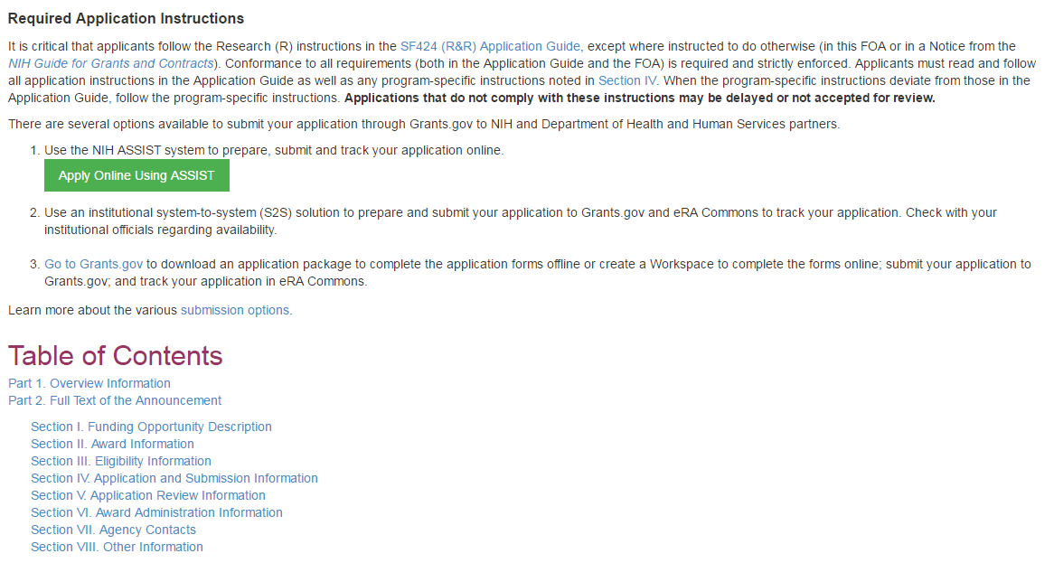
Initiate Application – ASSIST Example
Excerpt from FOA in NIH Guide…
Login with eRA Commons Username & Password

Slide 38
ASSIST Welcome Screen
Initiate Application

Slide 39
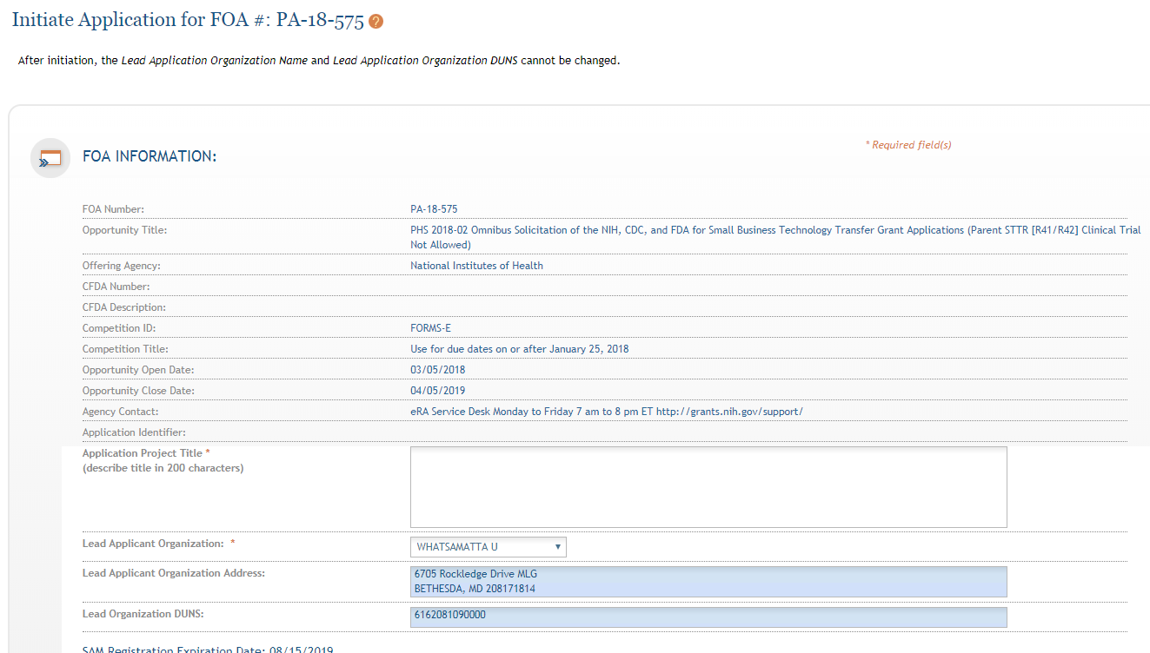
ASSIST Initiate Screen
FOA information pulled from Grants.gov
Enter Project Title
Drop-down list of organizations affiliated with your eRA Commons account
Data pre-populated from organization selection
39

Slide 40
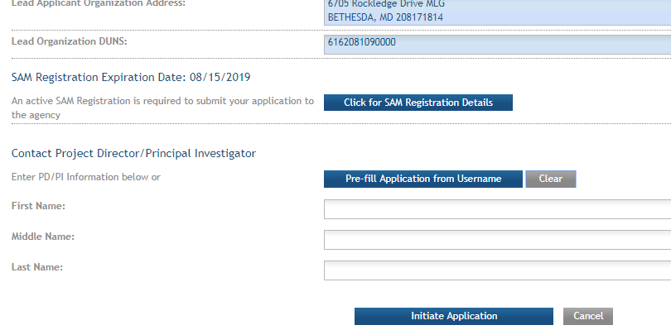
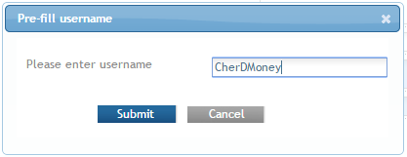
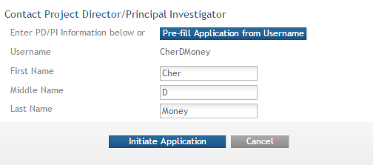
Initiate – Pre-population
Visibility to SAM registration expiration date & details
Can manually enter PD/PI information or provide eRA Commons username to auto-populate
If multiple employment records, select appropriate record for application.

Slide 41
ASSIST application initiation complete
41
ASSIST messages

Slide 42
Step 4: Build Your Team
Provide application access to appropriate team members
Gather eRA Commons usernames to include in your application for the following individuals
Project Director/Principal Investigators (PD/PIs)
Component leads on a multi-project application
Sponsor on a fellowship application
Candidates for diversity and re-entry supplements
Primary mentor on individual mentored career development application
ASSIST | Workspace
Gather eRA Commons usernames and use Manage Access to give folks access | Gather Grants.gov usernames and use Participants tab to give folks access

Slide 43
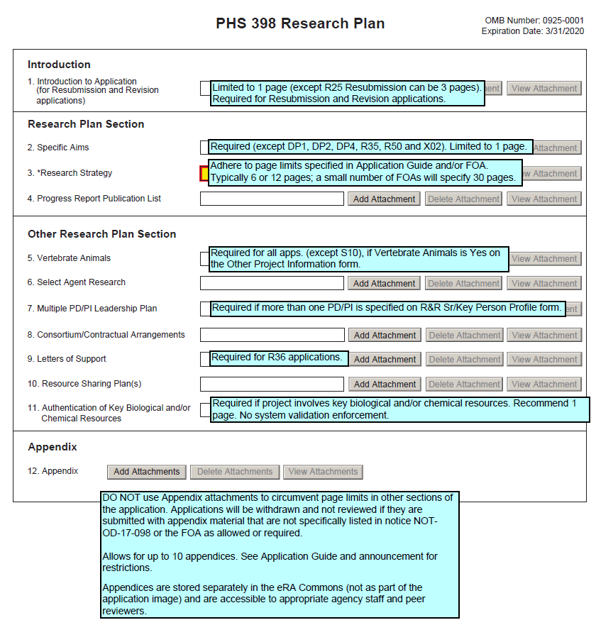
Step 5: Enter Data
Follow All Guidance
Handy Resource
Notices in NIH Guide for Grants & Contracts
Funding Opportunity Announcement
Section IV. Application and Submission Information
How to Apply - Application Guide
Annotated form sets
Precedence / Importance
https://grants.nih.gov/grants/how-to-apply-application-guide.html

Slide 44
Application Attachments
Use simple PDF-formatted files for all attachments
Disable security features such as password protection
Filenames must be unique within the application & 50 characters or less*
Use meaningful filenames
If FOA specifies a filename – use it!
“Other Attachments” on R&R Other Project Information form & “Other Clinical Trial-related Attachments” on PHS Human Subjects and Clinical Trials Info form use filenames as bookmarks
Limit the use of images to the Research Strategy*
Do not include headers or footers
Section headings as part of the text (e.g., Significance, Innovation, Approach) are encouraged
Follow guidelines for fonts and margins
Follow specified page limits
* Increased system enforcement
https://grants.nih.gov/grants/how-to-apply-application-guide/format-and-write/format-attachments.htm

Slide 45
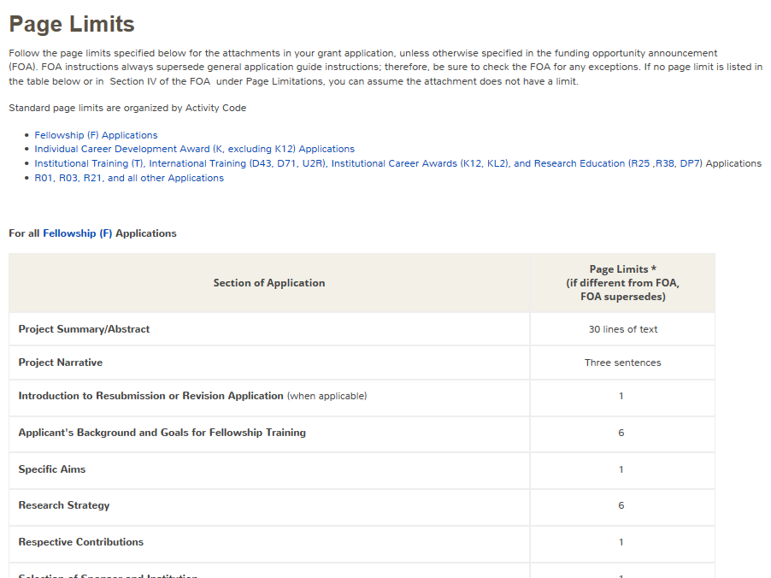
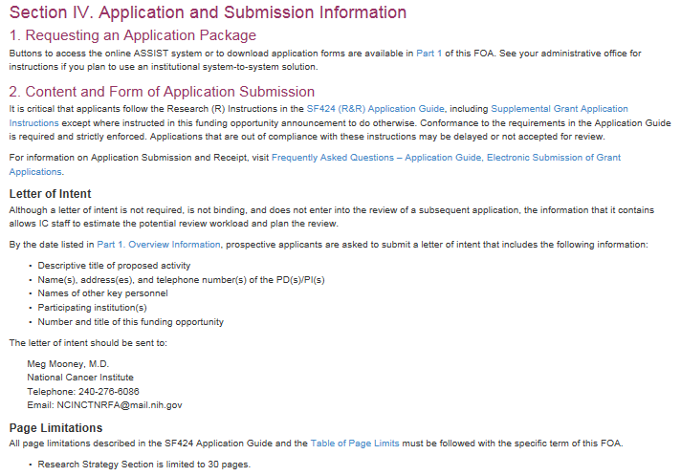
Follow Specified Page Limits
https://grants.nih.gov/grants/how-to-apply-application-guide/format-and-write/page-limits.htm

Slide 46
Text Fields
Text fields support plain text with limited manual formatting
To format paragraphs, include a blank line between paragraphs
To format bulleted lists, start each list item on a new line with a "list item" character, such as a hyphen (-) or an asterisk (*), followed by a space and then the item text
Much of your original formatting (font, bolding, bullets, subscript, superscript) will be lost when you cut and paste
Take advantage of application preview features
Check application form instructions for character limits
Spaces and punctuation count against the limit
https://grants.nih.gov/grants/how-to-apply-application-guide/format-and-write/rules-for-text-fields.htm

Slide 47
Use Format Pages
NIH Biosketch & SciENcv (Breakout 3G, Th. 1:45)
Biosketch Format Pages, Instructions and Samples
https://grants.nih.gov/grants/forms/biosketch.htm
Data Tables
https://grants.nih.gov/grants/forms/data-tables.htm
More (Additional Sr/Key, Additional Sites, Other Support)
https://grants.nih.gov/grants/forms/format-pages.htm
xTRACT & xTrain (Breakout 6D, Fri. 8:30)

Slide 48
Grantsmanship
Grant Writing for Success (Breakout 6G, Fri. 8:30)
Avoid jargon
Be focused - use a clear and concise writing style
Spell out acronyms with first use in each section/attachment and note the appropriate abbreviation in parentheses
Appeal to reviewers and funding ICs using language that stresses the significance of your proposed work
Align your application with the review criteria to maximize impact
FOA Section V. Application Review Information
https://grants.nih.gov/grants/how-to-apply-application-guide/format-and-write/write-your-application.htm

Slide 49
Avoiding the “Gotchas” * Small Group Exercise *
Refer to annotated form set:
https://grants.nih.gov/grants/how-to-apply-application-guide/resources/annotated-form-sets.htm

Slide 50
Step 6: Finalize Your Application
Action | ASSIST | Workspace
6a. Run a pre-submission validation check | Validate Application | Preview Grantor Validation
6b. Generate a pre-submission image of your assembled application in the NIH format | Preview Application | Grantor Image
6c. Take any additional steps needed to prepare for submission | Update Submission Status to “Ready to Submit” | Complete and Notify AOR (optional)

Slide 51
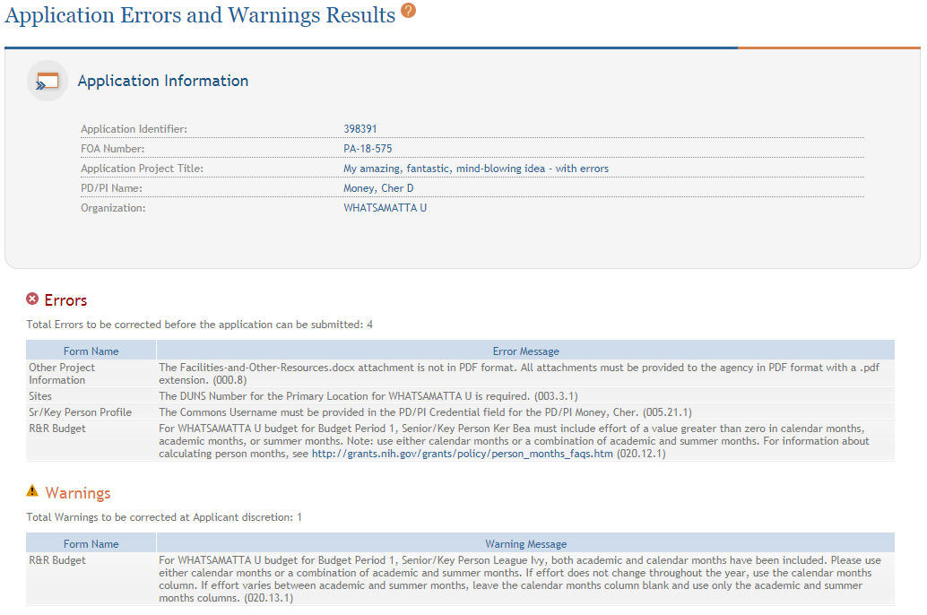
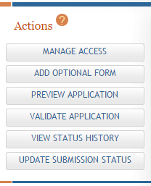
ASSIST: Validate Application
Errors and Warnings are displayed

Slide 52
Errors & Warnings
Errors stop application processing and must be corrected
Warnings do not stop application processing and are corrected at your discretion based on your circumstances

Slide 53
ASSIST: Preview Application
View last preview
Generate new preview

Slide 54
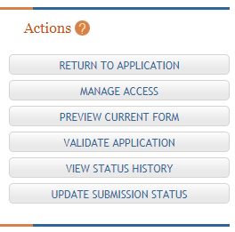
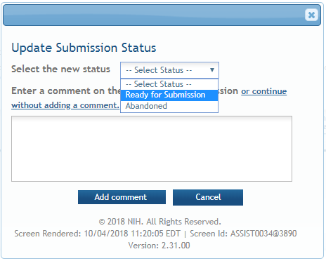
ASSIST: Update Submission Status
Select status
Enter comment to be added to status history

Slide 55
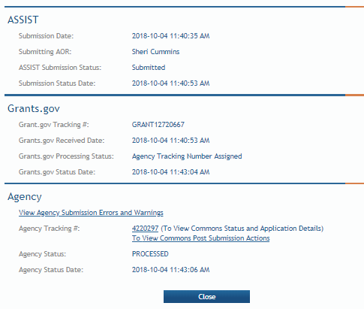
Step 7: Submit Your Application
Follow steps for your submission method
Only folks who hold Grants.gov credentials with the AOR (Authorized Organization Representative) role can submit
All NIH applications route through Grants.gov
Your Grants.gov timestamp is used to determine “on-time” submission
Grants.gov Tracking #
Date/Time Stamp – always recorded in Eastern Time

Slide 56
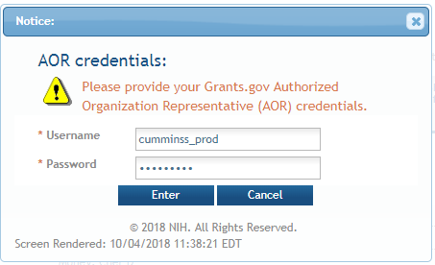
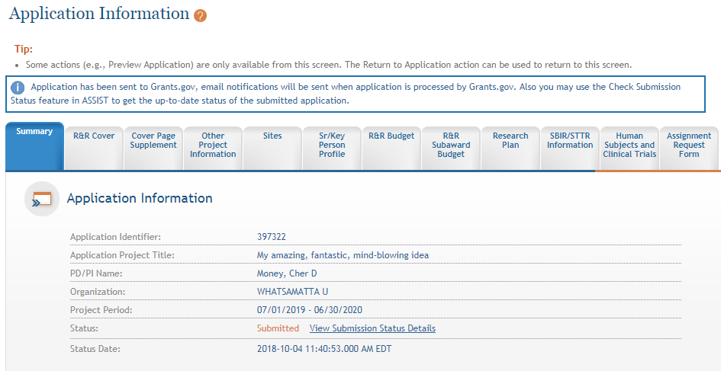
ASSIST: Submit
56
Applications are submitted from ASSIST to Grants.gov.
Enter your Grants.gov AOR credentials and click Enter.
Message will appear indicating the application was sent to Grants.gov.

Slide 57
On-time Submission
Deadline = 5 pm local time of submitting organization on the due date
All registrations and SAM renewal must be completed before the deadline
Application must be free of all federal system-identified errors (Grants.gov & eRA)
NIH’s late policy does not allow corrections after the deadline
Submit early! Allow time to correct any unexpected errors or submission issues

Slide 58
Pop Quiz
The appropriate measurement for “early” in the context of application submission is…
Minutes
Hours
Days
Measure early on a calendar not a clock.

Slide 59
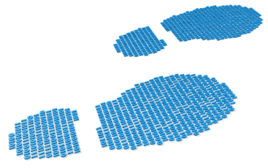
Step 8: Track Your Application
eRA Commons Status is an integral part of your submission
Applications that pass Grants.gov validations are picked up by eRA Commons and checked against many application guide and opportunity instructions
Authorized users can check eRA Commons Status for processing results
Signing Officials (SOs)
Administrative Officials (AOs)
Principal Investigators (PIs)
Delegated Assistants (ASSTs)
E-mail notifications sent

Slide 60
Email is Unreliable – Proactively Track Application
Many email notifications are sent throughout the process
DO NOT depend solely on email notifications
It is YOUR responsibility to proactively check your application status in eRA Commons
Grants.gov notifications go to email address associated with the submitting AOR’s Grants.gov account
eRA notifications go to the three email addresses on the SF424 (R&R) form submitted with the application (contact, PD/PI, AOR)
https://grants.nih.gov/grants/how-to-apply-application-guide/submission-process/submit-track-view/email_notifications.htm

Slide 61
Application Checks (Validations)
We really care about the details
Multiple levels of application checks for completeness
Grants.gov
eRA systems
Agency staff
Check!
Check!
Check!
https://grants.nih.gov/grants/how-to-apply-application-guide/submission-process/check-your-application.htm

Slide 62
Sample Validations
Grants.gov
eRA Systems
Agency Staff
Active System for Award Management (SAM) registration
Submitter has AOR role for DUNS on application
Submission made to active opportunity and application package
Virus check
Filenames include only appropriate characters
Fields required by agency, but not required federal-wide
R&R Sr/Key form
Credential for PD/PIs
Organization name for all sr/key
Biosketch for all sr/key
Performance Site form
DUNS for primary site
Attachments in PDF format
Filenames 50 characters or less
Adherence to page limits in our Table of Page Limits
Required attachments included
Fit with NIH/Institute mission
Eligibility
“Overstuffing”
On-time submission
Adherence to funding opportunity announcement or Guide notice instructions
Font and margin guidelines
Simultaneous review of essentially same application

Slide 63
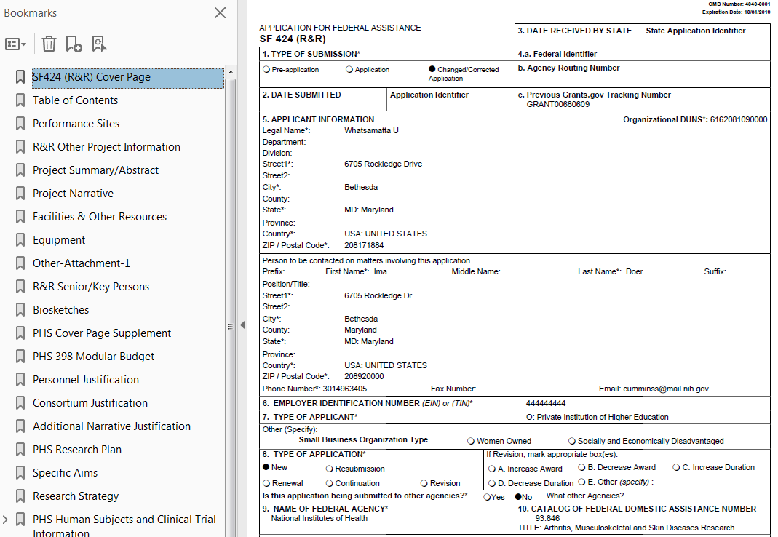
Application Assembled & Posted in eRA Commons
Once an error-free application is received by NIH, the eRA system will:
Assemble the grant application image
Insert headers (PI name) and footers (page numbers) on all pages
Generate Table of Contents and bookmark important sections
Post the assembled application image in the PD/PI’s eRA Commons account
Send notifications

Slide 64
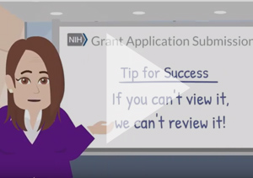
View Application Image (e-Application)
The e-Application in eRA Commons is the same document seen by NIH staff and reviewers.
e-Application does NOT include:
Cover Letter
Appendices
Assignment Request form
If you can’t view it, we can’t review it. If we can’t review it, we certainly can’t fund it.

Slide 65
Application Viewing Window
Applicants have two (2) business days to view the assembled application image before the application automatically moves forward for further processing
SO can Reject application within viewing window to prevent it from moving forward to NIH staff
Can submit a Changed/Corrected application before the submission deadline
We cannot resurrect a rejected application
ASSIST | Workspace
View Submission Status Details link | Must login to eRA Commons directly and access the application’s detailed status screen
https://public.era.nih.gov/commons

Slide 66
Submission Complete!
If you don’t reject within the two business day viewing window, the application automatically moves forward for further NIH processing
Any subsequent application changes are subject to
Late Applications (NOT-OD-15-039)
Post-Submission Application Materials Policy (NOT-OD-19-083)

Slide 67
What’s new or happening soon?

Slide 68
Applications Proposing Use of Human Fetal Tissue (HFT)
NIH Guide Notices: NOT-OD-19-128, NOT-OD-19-137
Due dates on/after September 25, 2019
Applications proposing the use of human fetal tissue (HFT) from elective abortions must include
Justification of the use of HFT
Details regarding procurement and costs (using R&R Budget form)
Information about how the applicant will use HFT
New section added to the Cover Page Supplement Form (Forms-F)
Applications that do not address all required information will be withdrawn without review

Slide 69
ORCID iDs
ORCID iDs are free, unique identifiers
Connect researchers and their contributions to science over time and across changes of name, location, and institutional affiliation
NIH Guide Notice: NOT-OD-19-109
Due dates on/after January 25, 2020
PD/PIs on Fellowship and Career Development applications must have ORCID iDs linked to their eRA Commons Personal Profiles at time of application

Slide 70
Updated Application Forms (FORMS-F)
Update reflects latest versions of forms approved by the Office of Management and Budget (OMB)
Must use application packages with a Competition ID of “FORMS-F” for due dates on/after May 25, 2020
Resources
NIH Guide Notice
Preview of Grant Application Form Changes (FORMS-F)
Do I Have the Right Forms for my Application?
FAQs

Slide 71
Unique Entity Identifier (UEI)
NIH Guide Notice – NOT-OD-19-098
Effort led by U.S. General Services Administration (GSA) to transition from DUNS to a SAM-issued identifier to uniquely identify entities doing business with the government
GSA Unique Entity Identifier Update page
Future application form changes are likely, but are not planned as part of FORMS-F update

Slide 72
Finding Help
Help Desks
On-line resources & Web sites

Slide 73
Help Desks
eRA Service Desk
Grants.gov Contact Center
Web: https://grants.nih.gov/support/
Phone: 1-866-504-9552
Hours : Mon-Fri, 7a.m. to 8 p.m. ET
Toll-free: 1-800-518-4726
Hours : 24x7 (Except Federal Holidays)
Email : support@grants.gov
Resources: https://www.grants.gov/web/grants/support.html

Slide 74
Online Resources & Websites
NIH Grants and Funding https://grants.nih.gov/grants/oer.htm
How to Apply – Application Guide https://grants.nih.gov/grants/how-to-apply-application-guide.htm
Annotated form set https://grants.nih.gov/grants/how-to-apply-application-guide/resources/annotated-form-sets.htm
Preparing Your Application Using ASSIST https://grants.nih.gov/grants/how-to-apply-application-guide/prepare-to-apply-and-register/submission-options/assist.htm
Get Started on Your Workspace Application https://www.grants.gov/web/grants/applicants/workspace-overview.html

Slide 75
Stay Connected – Subscribe to Listservs
Electronic Research Administration News (eRA-Information-L)
Used by NIH to notify the community of information related to eRA Commons, ASSIST & eSubmission.
NIH Guide to Grants and Contracts (NIHTOC-L)
Weekly email with a summary of all NIH Guide announcements published during the week, called the Current Weekly Table of Contents (TOC).
NIH Extramural Nexus (EXTRAMURALNEXUS)
Provides regular updates on NIH grants policies and activities that impact the entire grants community.
https://grants.nih.gov/news/subscribe-and-follow/listservs_and_rss.htm

Slide 76
Questions?

